Slide 1
— Progress on Point-Cloud-Res-Net (PCRN)
Alexandre Duperre
September 9th 2019
Notes:
To create Em dash above headline:
Same size and weight as the headline and set using a soft return.
PC: Em dash (—): Alt+Ctrl+ - (minus)
Mac: Em dash (—): Shift+Alt/Option+hyphen

Slide 2
Table of contents
Method
Datasets
Model 1 - PCRN
Model 2 – PrimalNet
Futur improvements

Slide 3
Objective : Classification from depth information
i.e.: 2.5D images

Slide 4
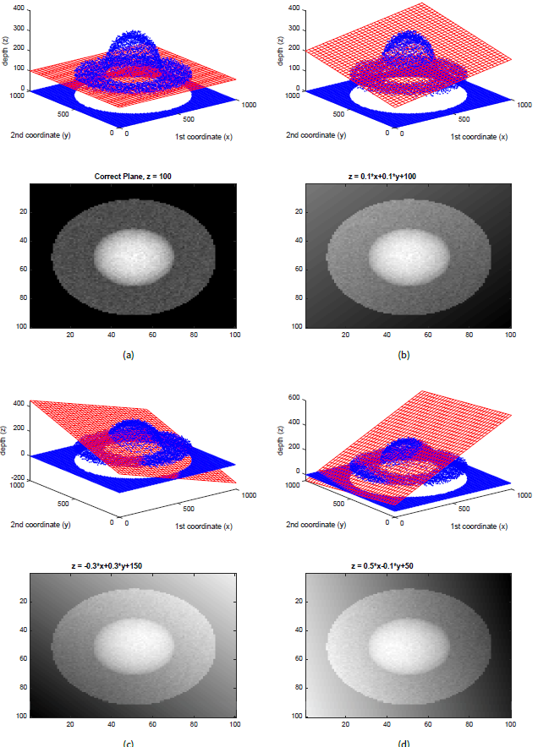
Method : 3D Residuals
Hypothesis: 3 residual images for each basic shape is enough to reconstruct the 2.5D image
Our algorithm will learn the best parameters corresponding to each parametric shape
i.e.:
3 planes = 3 sets of parameters
3 spheres = 3 sets of parameters
3 cylinders 3 sets of parameters
…

Slide 5
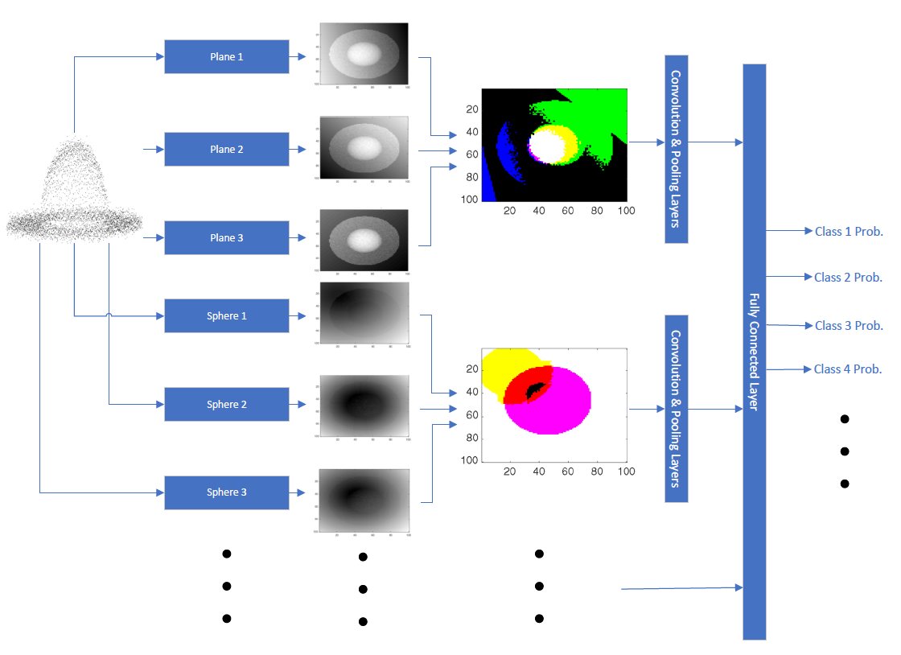
Method : 3D Residuals
Hypothesis: Merging the Residual network with a powerful classifier will yield good accuracy performances
The first algorithm calculates the residual images with respect to the shapes learned so far.
The 3 residual images per shape are then fed to the ResNext101_32-4d.

Slide 6
Datasets : 3D models
ShapeNet V2 & ModelNet40

Slide 7


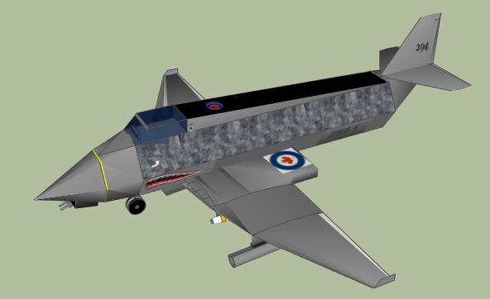




Preprocessing
From 3D models (.obj) to multi-view (MV) 2.5D image
Stanford ShapeNet Renderer (Panamari, 2018)
Pixel value inversion needed

Slide 8
Model 1 : PCRN
PlaneResLayer
Conv Block
ResNext101-32x4d
PlaneResLayer
Outputs
[B, 3, H, W]
[B, 3, H*W]
PlaneResLayer
[B, 3*ConvBlock_out, H, W]
ShpereResLayer
Conv Block
ShpereResLayer
ShpereResLayer
CylResLayer
Conv Block
CylResLayer
CylResLayer
ResBlocks

Slide 9
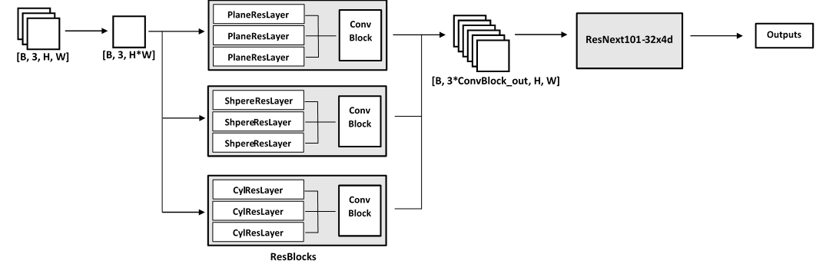
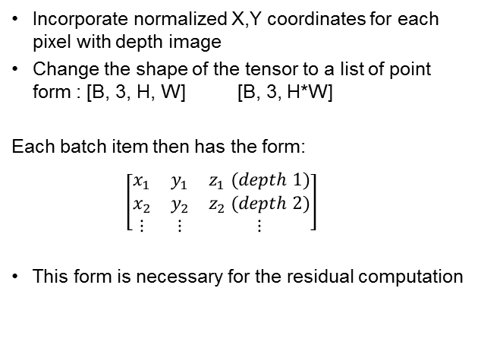
Prepare the data
Incorporate normalized X,Y coordinates for each pixel with depth image
Change the shape of the tensor to a list of point form : [B, 3, H, W] [B, 3, H*W]
Each batch item then has the form:
$\left[\begin{matrix}x_{1} & y_{1} & z_{1} (depth 1) \\ x_{2} & y_{2} & z_{2} (depth 2) \\ ⋮ & ⋮ & ⋮\end{matrix}\right]$
This form is necessary for the residual computation

Slide 10
Compute Residuals
Each ResBlock contains three ResLayers that are responsible for calculating a residual image with respect to their own individual parameters
The three residual images are concatenated along the channel dimension
The three channel residual image is fed to a small convolutional neural network
The output is a stacked 3*ConvBlock_out channels tensor with a new H and W

Slide 11
Feed ResNext101_32-4d
Modify the first convolution layer of ResNext101-32-4d to receive more than three channels
Modify the last linear fully connected layer to compensate the image size variation
Modify the number of classes at the end

Slide 12

Other features
Weight clipper : keep parametric shape parameters within 0,1 range
Tuneable learning rate for the ResidualNet layer
Confusion matrix generator
Shape evolution throughout training

Slide 13
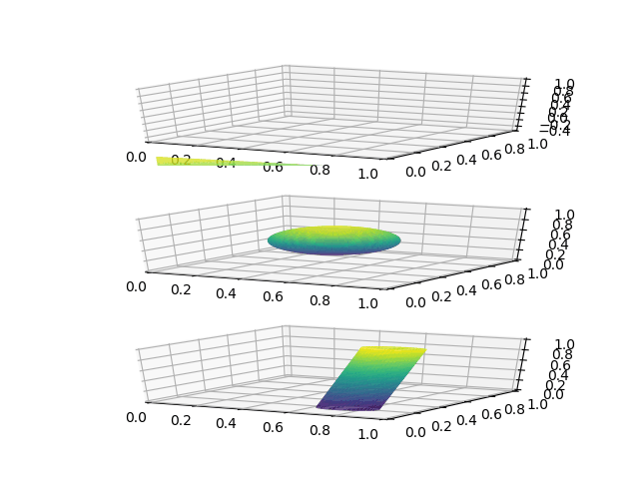

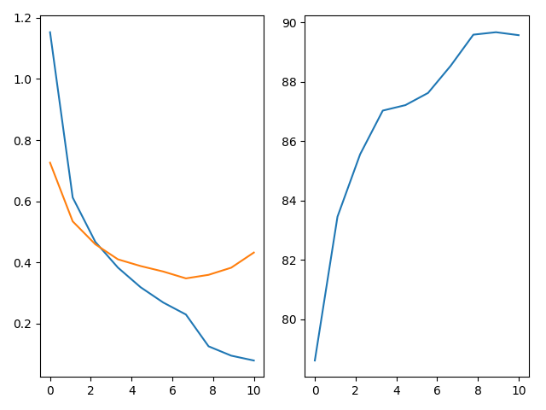
Results - PCRN
Validation Accuracy
Loss
Training
Validation
Shape evolution without layer specific learning rate
Shape evolution with layer specific learning rate
Learning curves
Test accuracy : 89.69%

Slide 14
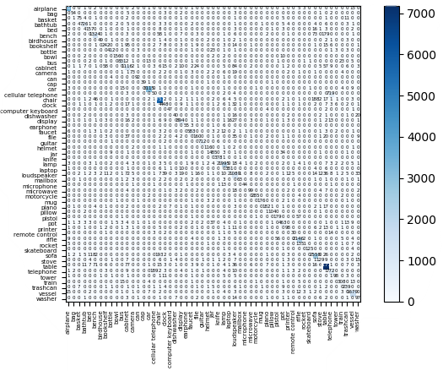
Results - PCRN
Confusion Matrix
Phone is mistaken for cellular phone
Chair is mistaken for sofa or bench
Table is mistaken for bench
Loudspeaker is mistaken for cabinet
etc,

Slide 15

Model 2 : PrimalNet
d = 1
1x1 Conv
ResNext101-32x4d
Outputs
x, y, z
x, y, z
n = 3
d = 2
1x1 Conv
x, y, z, xy, xz, yz, x², y², z²
d = N
1x1 Conv
$\left(\frac{d+n−1}{n−1}\right)$ channels

Slide 16
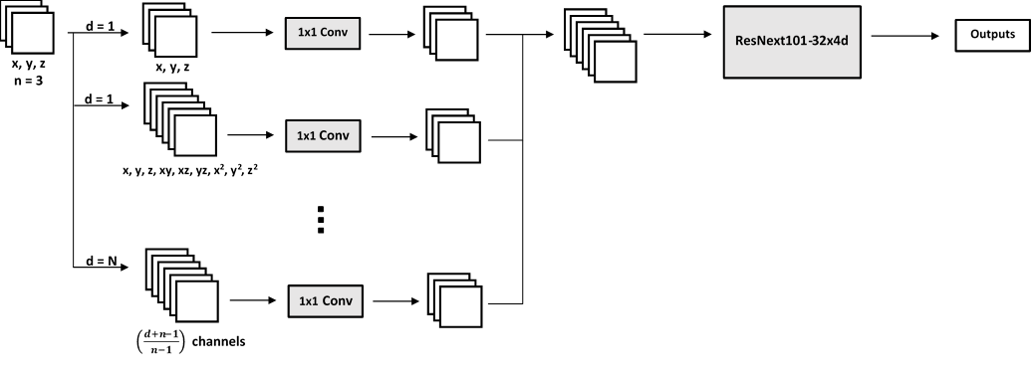

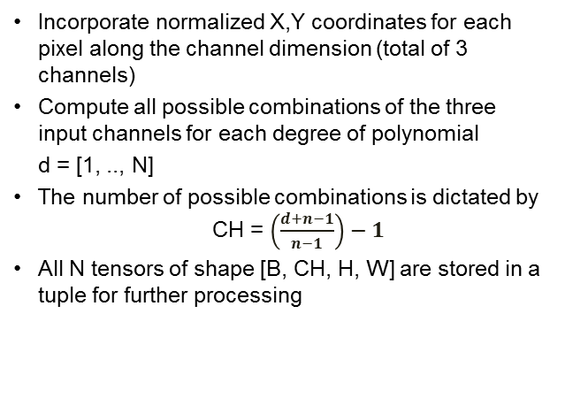
Prepare the data
Incorporate normalized X,Y coordinates for each pixel along the channel dimension (total of 3 channels)
Compute all possible combinations of the three input channels for each degree of polynomial
d = [1, .., N]
The number of possible combinations is dictated by CH = $\left(\frac{d+n−1}{n−1}\right)−1$
All N tensors of shape [B, CH, H, W] are stored in a tuple for further processing
1
Notes:
complete homogeneous symmetric polynomials.

Slide 17
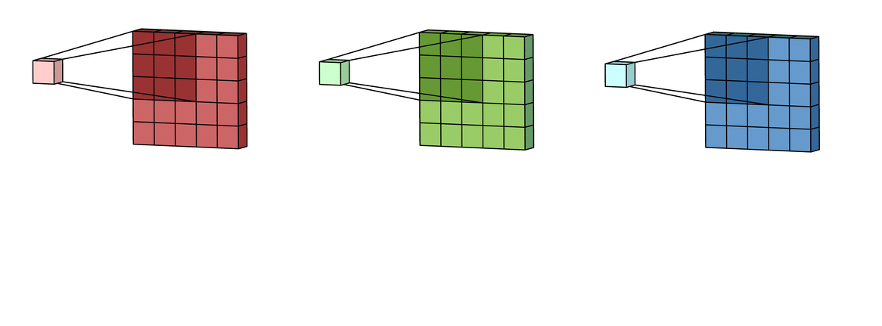
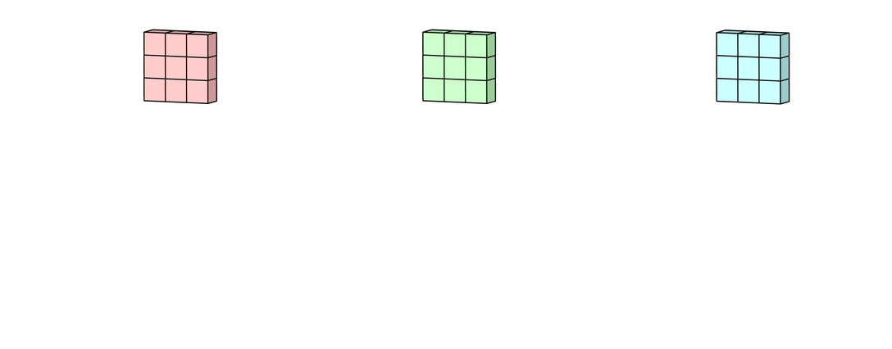
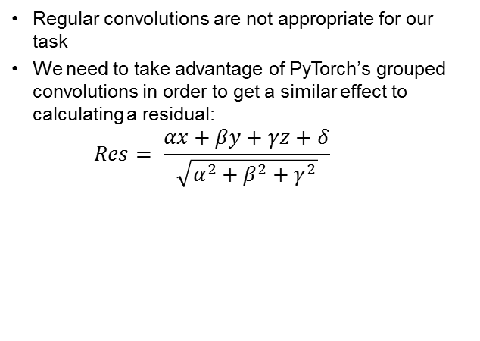
1x1 Convolution layer
1
Regular convolutions are not appropriate for our task
We need to take advantage of PyTorch’s grouped convolutions in order to get a similar effect to calculating a residual:
$$Res= \frac{αx+βy+γz+δ}{\sqrt{α^{2}+β^{2}+γ^{2}}}$$

Slide 18
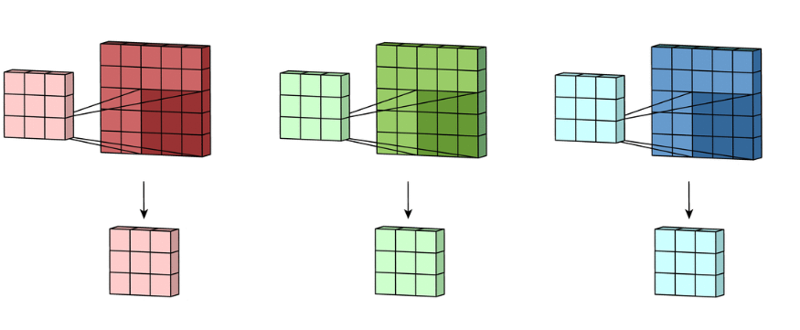
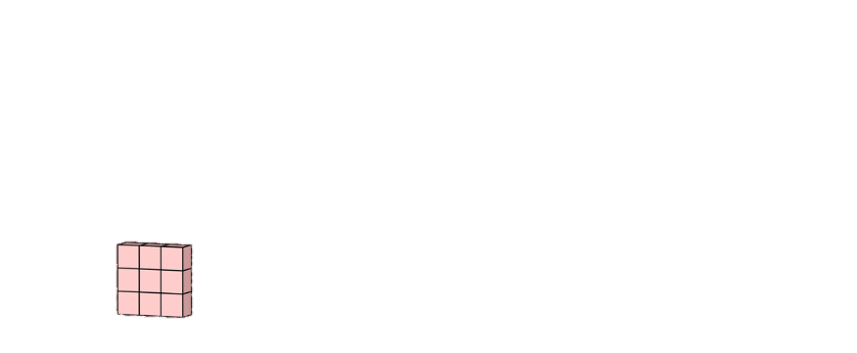

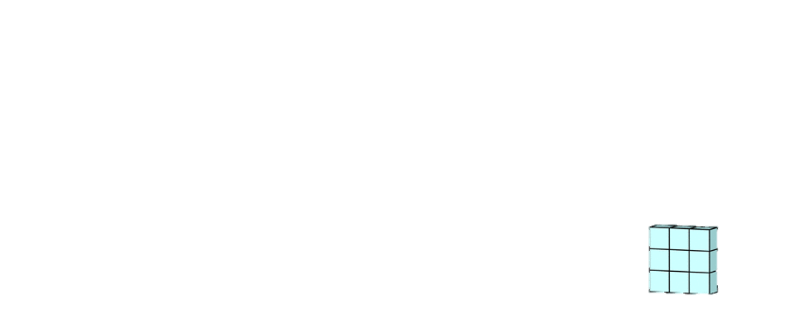
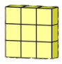
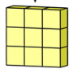
1x1 Convolution layer
x
y
z
1
+
+
+
1
Each combination of the input (channels of the tensor) are processed by a grouped convolution with as many groups as input channels
Number of output channels is three times number of input channels
Each input then has three individual kernels applied to it
Finally, all of the firsts, all of the seconds and all of the thirds feature maps are summed together

Slide 19
Feed ResNext101_32-4d
Modify the first convolution layer of ResNext101-32-4d to receive more than three channels
Modify the last linear fully connected layer to compensate the image size variation
Modify the number of classes at the end
1

Slide 20
Other features
Tuneable learning rate for the ResidualNet layer
Confusion matrix generator

Slide 21
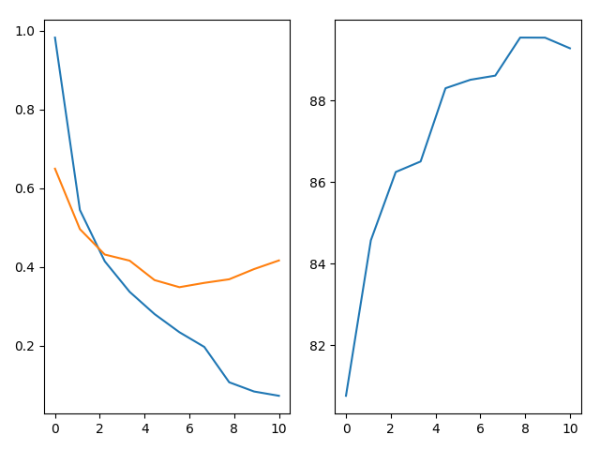
Results - PrimalNet
Validation Accuracy
Loss
Training
Validation
Learning curves
Test accuracy : 89,47%

Slide 22
Future improvements
ConvBlock in PCRN
Connection between the ResidualNet and ResNext
Weight normalization for PrimalNet
No manual seed
Random initialization of the shapes
Add colour image – similar to MVCNN
Validation-test sets size

Slide 23
Suggestions / Questions?

